Slide 1
Federal Coordinating Center (FCC) What They Are and Are Not
VHA Office of Emergency Management
Health Care Coalition Task Force Meeting
July 18, 2023

Slide 2
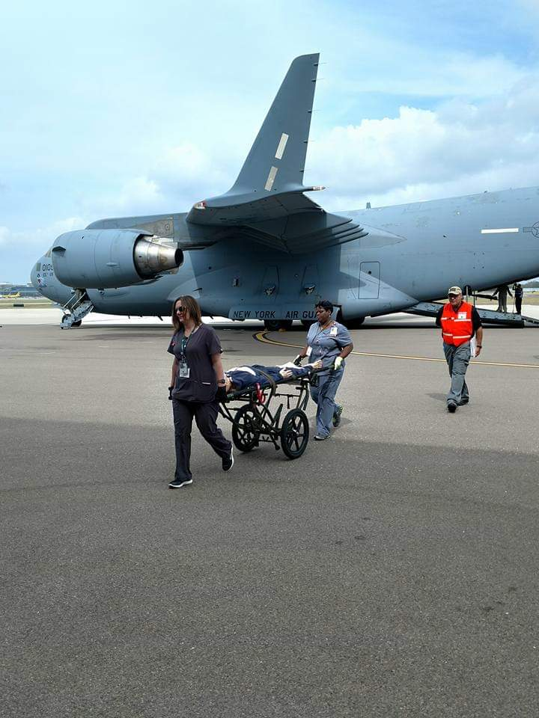
Federal Coordinating Center (FCC) What they are and are not
Department of Veterans Affairs
VHA Office of Emergency Management
Darryl Stevenson- Tampa FCC Coordinator
Dawn Stevenson Miami FCC Coordinator
Notes:
Introductions and background
Go around the room for introductions

Slide 3
National Disaster Medical System (NDMS)
FCCs are apart of the National Disaster Medical System (NDMS)
NDMS: DoD, HHS, DHS (FEMA)
Medical Response (HHS DMATs and other teams)
Evacuation (DoD Airlift)
Patient Reception (VA and DoD FCCs)
Definitive Care – Coordinated by DoD and VA medical facilities that are designated as Federal Coordination Centers.
OEM AEMs have primary responsibility in the assigned VA FCCs for coordination and planning of NDMS with the private sector.
Notes:
BACKGROUND
The National Disaster Medical System. In 1984, the Department of Health and Human Services (HHS), DoD and the Federal Emergency Management Agency (FEMA) created the NDMS as a cooperative, asset-sharing partnership. VA joined the partnership in 1987 by signing a Memorandum of Agreement (MOA) with HHS, DoD and the Department of Homeland Security (DHS). NOTE: For more information on the NDMS MOA, see National Disaster Medical System Memorandum of Agreement Among the Departments of Health and Human Services (HHS), Veterans Affairs (VA), Defense (DoD), and Homeland Security (DHS), dated October 24, 2005 at https://dvagov.sharepoint.com/sites/VHAregprogs/EMSHG/PLN/FCC/default.aspx. NOTE: This is an internal VA website that is not available to the public.
The NDMS fulfills three main goals:
to provide supplemental health and medical assistance in domestic disasters at the request of State and local authorities;
to evacuate patients who cannot be cared for in the disaster area to designated locations elsewhere in the Nation; and
to provide a nationwide network of voluntary, pre identified, civilian health care facilities capable of providing definitive care for the victims of domestic disasters and military contingencies that exceed the capabilities of the affected local, State or Federal medical system.
VHA participates in NDMS through VA medical facilities designated as FCCs. FCCs receive, triage, stage, track and coordinate transport for civilian patients relocated to NDMS-participating medical facilities capable of providing the required definitive care.

Slide 4
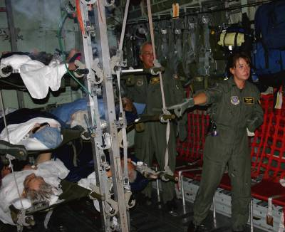
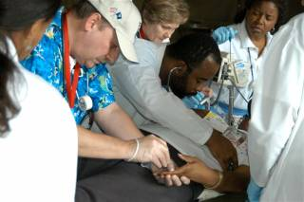
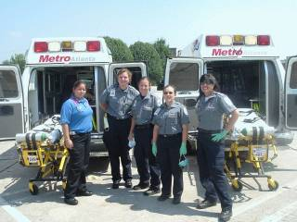
Federal Coordinating Center (FCC)
A facility located in a metropolitan area of the United States responsible for day-to-day coordination of planning and operations in one or more assigned geographic NDMS Patient Reception Areas (PRAs).
Notes:
VHA coordinates the receipt and distribution of civilian national emergency casualties for definitive medical care at NDMS health care facilities through Federal Coordinating Centers (FCCs) at major metropolitan areas across the United States.
VHA is also responsible for receipt, distribution and definitive medical care of prioritized military casualties in support of the VA-DoD Contingency Plan during armed conflicts or national emergencies.

Slide 5
Federal Coordinating Centers (FCCs)
Notes:
64 FCCs
VA FCC-50
DOD FCCs
Army-6
Navy-5
Air Force- 3

Slide 6
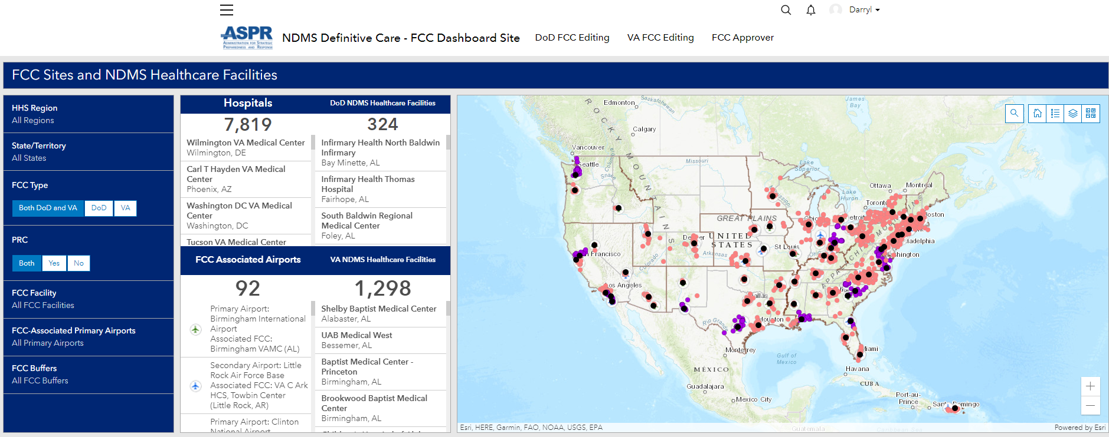
Federal Coordinating Centers (FCCs)

Slide 7
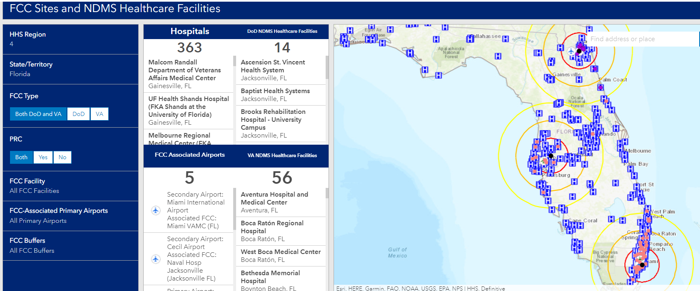
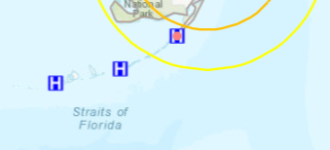
Florida’s (FCCs)

Slide 8
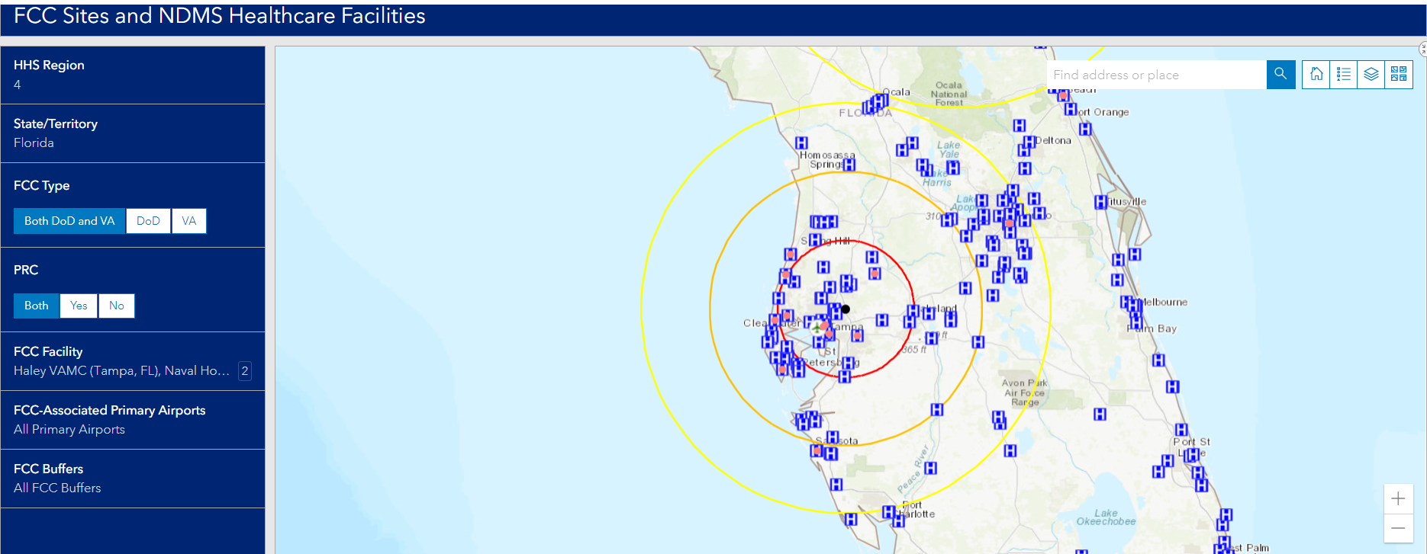
Tampa Primary Receiving Area (PRA)
PRA- Tampa International Airport
Notes:
Rick

Slide 9
FCC Tampa
Facility: James A. Haley VAMC
FCC Director: David K. Dunning
FCC Coordinator: Darryl Stevenson
PRA- Tampa International Airport
NDMS Partner Hospitals-
26 out of 130 NDMS healthcare facilities have a signed MOA ​
Current Activities:
NDMS MOA Updates
FCC/NDMS Steering Committee
Update Tampa FCC Plan
AAR for FSE (April 13, 2023)
Key Supporting Agencies:
Tampa International Airport
Sheltair Aviation Services
Tampa Fire Rescue
Hillsborough County EOC
Hillsborough County DOH
Hillsborough County Medical Reserve Corp
American Red Cross
Tampa Bay Health and Medical Preparedness Coalition

Slide 10
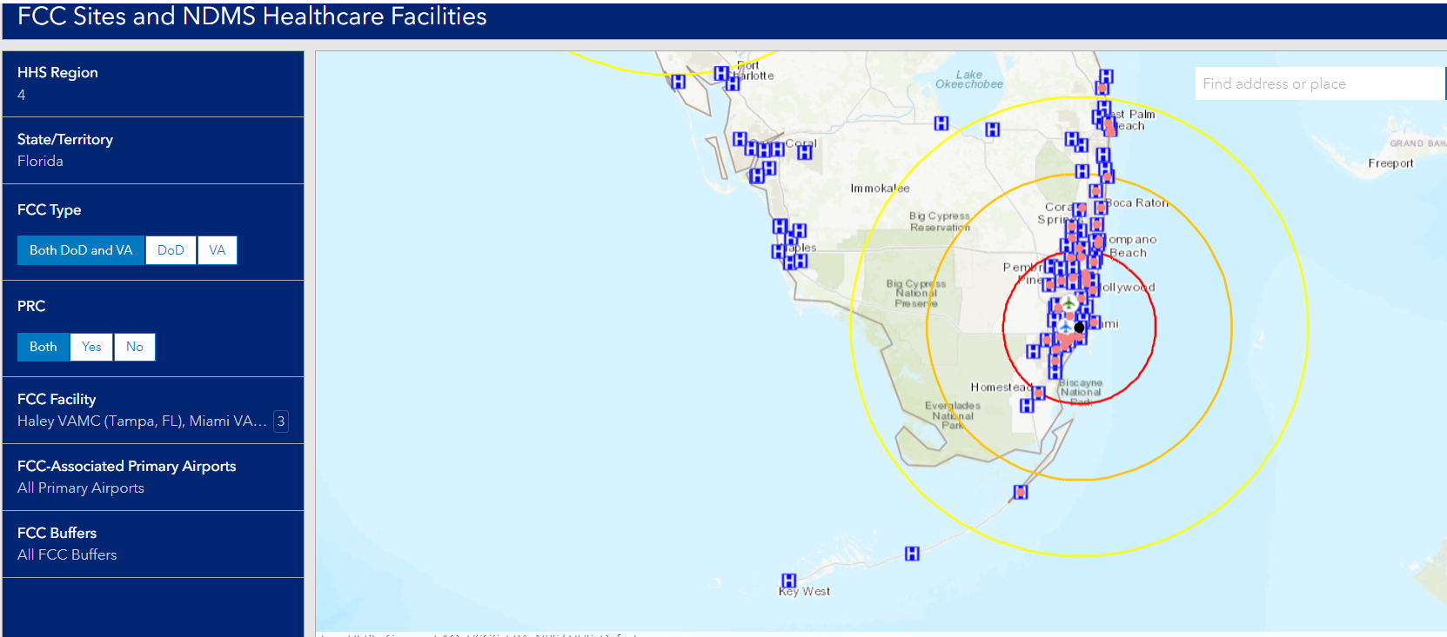
Miami Primary Receiving Area (PRA)
PRA-United State Coast Guard Miami Air Station Opa-Locka, FL

Slide 11
FCC Miami
Facility: Bruce W. Carter VAMC
FCC Director: Kalautie JangDhari
FCC Coordinator: Dawn Stevenson
PRA-USCG Miami Air Station Opa-Locka, FL
NDMS Partner Hospitals-
7 of 88 hospitals with signed MOAs​
Current Activities:
NDMS MOA Update
Update FCC Miami Plan
FCC/NDMS Steering Committee
Coordinating TTX / Training
Key Supporting Agencies:
Miami Veterans Affairs Healthcare System
Miami-Dade EOC
Miami-Dade County Healthcare Coalition
Broward County Healthcare Coalition
South Florida Federal Executive Board
RDSTF Region-7
American Red Cross

Slide 12
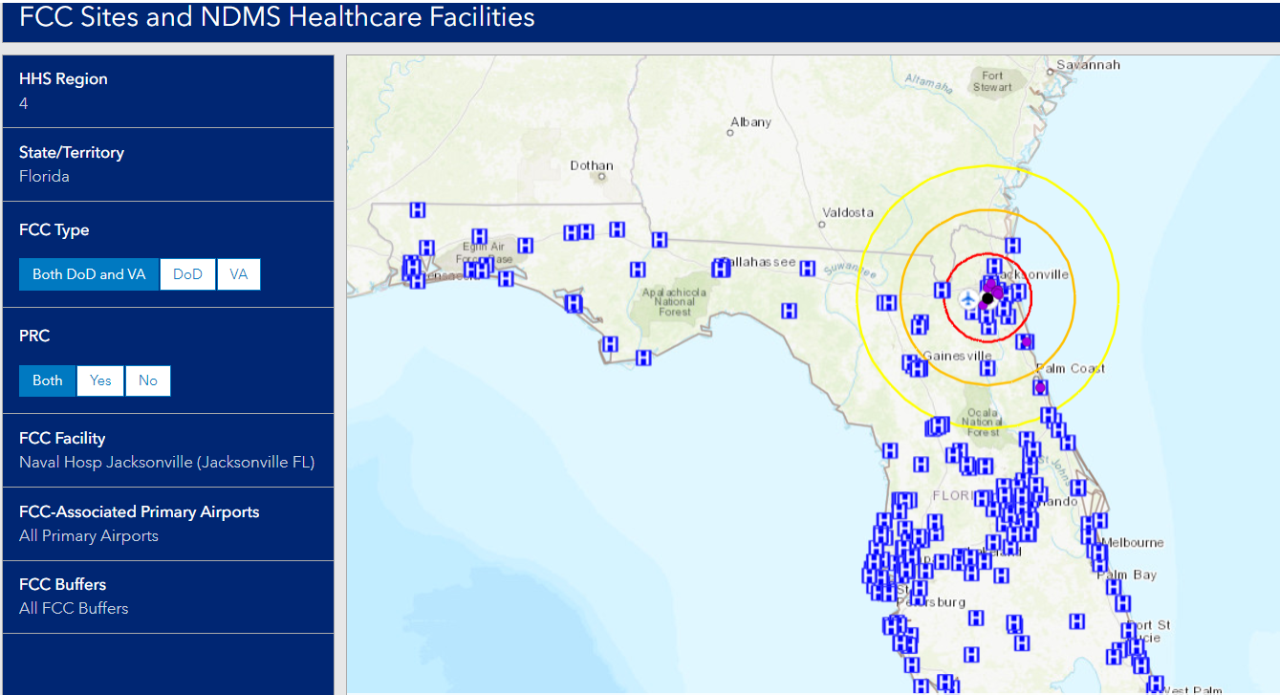
Naval Hosp Jacksonville Primary Receiving Area (PRA)
PRA- Naval Air Station Jacksonville (NAS JAX)

Slide 13
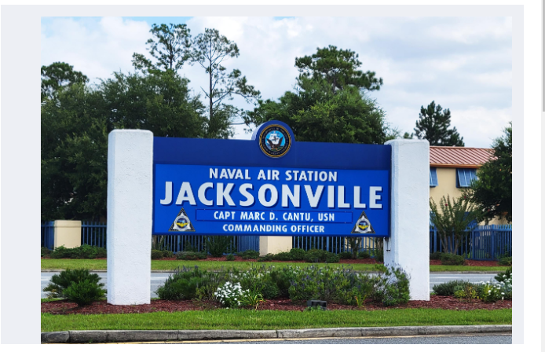
FCC Jacksonville (DoD)
Naval Air Station Jacksonville (NAS JAX)
FCC Coordinator: Senior Chief Kaitlen Doyle
PRA- Naval Air Station Jacksonville (NAS JAX)
MACS(EXW) Doyle, Kaitlen
Emergency Manager
NRMTC Jacksonville
Office: 904-542-7182
Cell: 904-238-4047
kaitlen.b.doyle.mil@health.mil
Notes:
Rick

Slide 14
Expansion of Participation in Florida

Slide 15
Possible Misconceptions
FCCs are for Patient RECEPTION only – there is no such thing as a “Reverse FCC”
Determination on which evacuees require medical care and hospital admission are done by physicians at the hospital, not the patient reception area
VA coordinates the FCC activity, but HHS manages the program. Discharge and final disposition of evacuees are coordinated by HHS Case Management

Slide 16
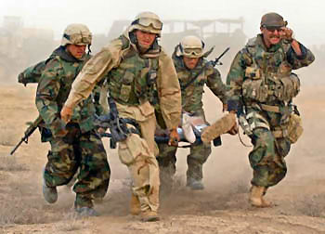
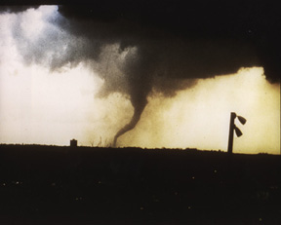
National Disaster Medical System
Definitive Medical Care Memorandum of Agreement (MOA)
Notes:
Darryl:

Slide 17
NATIONAL DISASTER MEDICAL SYSTEM PARTNER HEALTHCARE FACILITY MEMORANDUM OF AGREEMENT FOR DEFINITIVE MEDICAL CARE
Parties of the Agreement
Partner Healthcare Facility
National Disaster Medical System (NDMS)
(HHS, DOD,DHS, VA)
Authority
This Agreement is authorized under Section 2812 of the Public Health Service Act, 42 U.S.C. 300hh-11, as amended.
Purpose
To establish a formal relationship between the NDMS and NDMS partner healthcare facilities to ensure a network is in place to provide care for NDMS federal patients,
Notes:
17
Darryl:

Slide 18
MOA Section 4 Responsibilities (The NDMS partner healthcare facility)
The NDMS partner healthcare facility, as appropriate and based upon their resources and availability, agrees to:
Participate in scheduled FCC Exercises
Report the number of its available, equipped, and staffed beds (i.e., medical-surgical, critical care, pediatric, burn, psychiatry, pediatric intensive care unit and negative pressure/isolation)
Admission, treatment, and discharge of NDMS federal patient(s), and/or transfer to secondary healthcare facilities as medically necessary.
Sanitize and track any NDMS federal patient’s medical equipment, referred to as “patient movement items” (PMI) in accordance with local infection control guidelines and facility protocol before releasing the PMI to the designated personnel.
Notes:
18
Healthcare Facility Responsibilities.
Participate in scheduled FCC Exercises ( When asked to participate)
Report the number of its available, equipped, and staffed beds
medical-surgical
critical care
pediatric
burn
psychiatry
pediatric intensive care unit
negative pressure/isolation)
Admission, treatment, and discharge of NDMS federal patient(s), (based on bed availability)
Sanitize and track any NDMS federal patient’s medical equipment,

Slide 19
MOA Section 4 Responsibilities (The NDMS Federal Partners)
B. The NDMS Federal Partners (i.e., HHS, DHS, DoD, and VA) are responsible for
Transportation of NDMS federal patient(s)2 from the VA or DoD designated Patient Reception Site (PRS) to the NDMS partner healthcare facility
Assessing the real-time status of bed availability and discuss potential patient placement with the NDMS partner healthcare facility to ensure they are able to accept the NDMS federal patient(s) according to the patient(s) current medical needs.
Collaborating with the NDMS partner healthcare facility and serve as a facilitator to ensure patient care coordination needs and discharge planning is accomplished.
Returning the NDMS federal patient(s) evacuated through NDMS to their home of record or other final destination.
Facilitating the final disposition of the deceased in instances when an NDMS federal patient expires while at the NDMS partner healthcare
Notes:
19
Darryl:

Slide 20
MOA Section 5 REIMBURSEMENTS
The HHS, as payer, will define the “NDMS federal patient,” which is usually a patient that is transported via federal assets, processed through an FCC, and referred to NDMS partner healthcare facilities and/or healthcare practitioners for definitive medical care and tracked in JPATS.
Notes:
20
Eligible Patients
A condition of NDMS coverage is that the patient is transported via Federal assets, processed through a Federal Coordinating Center (FCC), and referred to facilities or practitioners for definitive medical care. The NDMS tracks all NDMS federal patients who are transported via Federal assets and thus, are eligible for coverage under this program. Authorized emergency response and disaster relief personnel responding to the public health emergency who suffer injuries or illnesses are also eligible for NDMS Definitive Care coverage.

Slide 21
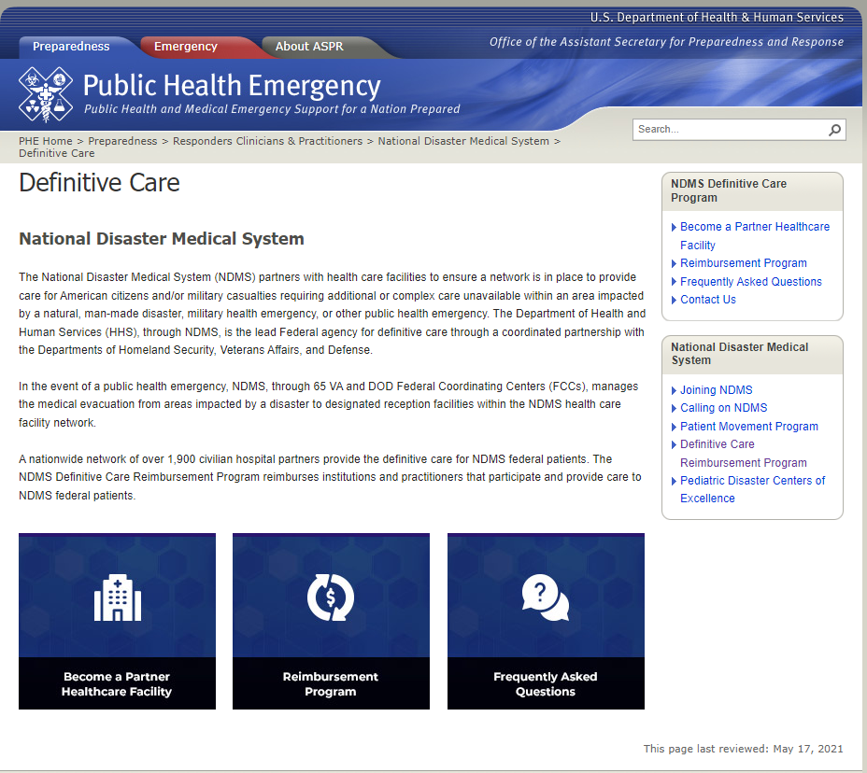
MOA Section 5 REIMBURSEMENTS (Cont.)
https://www.phe.gov/Preparedness/responders/ndms/definitive-care/Pages/default.aspx
Notes:
Patient Eligibility and Coverage Guidelines
NDMS Definitive Care Reimbursement Program
Eligible Patients
A condition of NDMS coverage is that the patient is transported via Federal assets, processed through a Federal Coordinating Center (FCC), and referred to facilities or practitioners for definitive medical care. The NDMS tracks all NDMS federal patients who are transported via Federal assets and thus, are eligible for coverage under this program. Authorized emergency response and disaster relief personnel responding to the public health emergency who suffer injuries or illnesses are also eligible for NDMS Definitive Care coverage. Covered Services
Generally, any medically necessary service which is authorized under Medicare Part A, Medicare Part B or a State’s Medicaid program is eligible for reimbursement as long as the NDMS federal patient sustained one of the following:
injuries or illnesses resulting directly from a specified public health emergency; or
injuries, illnesses and conditions requiring essential medical services necessary to maintain a reasonable level of health temporarily not available as a result of the public health emergency; or
injuries or illnesses affecting authorized emergency response and disaster relief personnel responding to the public health emergency.
Coverage Period
The NDMS Definitive Care Reimbursement Program coverage ends when one or more of the following conditions is met:
the patient’s medically indicated treatment ends (maximum reimbursable duration of 30 days);
the patient voluntarily refuses care;
thirty calendar days have elapsed from the date of the patient’s evacuation/placement; or
the patient is returned home or to the point of origin (or a fiscally comparable location) or to the patient’s destination of choice.
Coordination of Benefit Guidelines
The NDMS Reimbursement Program will pay primary under the following circumstances:
the patient is uninsured;
the patient is covered only by Medicaid; or
the patient is only covered by other state or local payer of last resort.
Note: the NDMS Definitive Care Reimbursement Program does not supersede contracts that providers have with other payers which require the payer’s reimbursement be accepted as payment in full (also referred to as “Assignment”). In these cases where the provider has agreed to accept Assignment from another payer, the NDMS Definitive Care Reimbursement Program will not make any secondary payments.
The NDMS Definitive Care Reimbursement Program will make no primary or secondary payments for patients with:
TRICARE coverage.
Medicare coverage.
Free care-eligible veterans treated in Veterans Affairs hospitals

Slide 22
MOA Section 5 REIMBURSEMENTS (Cont.)
B. For care provided to NDMS federal patients, subject to the availability of appropriations, reimbursements will be limited to:
• Injuries or illnesses resulting directly from the specified public health emergency;
• Injuries, illnesses, and conditions requiring essential medical treatment or services necessary to maintain a reasonable level of health when such medical treatment or services are temporarily not available as a result of the public health emergency; and
• Injuries or illnesses affecting authorized emergency response and disaster relief personnel responding to the public health emergency.
Notes:
22
Covered Services
Generally, any medically necessary service which is authorized under Medicare Part A, Medicare Part B or a State’s Medicaid program is eligible for reimbursement as long as the NDMS federal patient sustained one of the following:
injuries or illnesses resulting directly from a specified public health emergency; or
injuries, illnesses and conditions requiring essential medical services necessary to maintain a reasonable level of health temporarily not available as a result of the public health emergency; or
injuries or illnesses affecting authorized emergency response and disaster relief personnel responding to the public health emergency.

Slide 23
MOA Section 5 REIMBURSEMENTS (Cont.)
The following table identifies the various providers, sources of funding for NDMS health care facility reimbursement, and the order of payment.
The Provider agrees to seek reimbursement in accordance with this table. The NDMS will reimburse the Provider for medical treatment or services rendered by the Provider as indicated in the following table.
Notes:
23
Darryl:

Slide 24
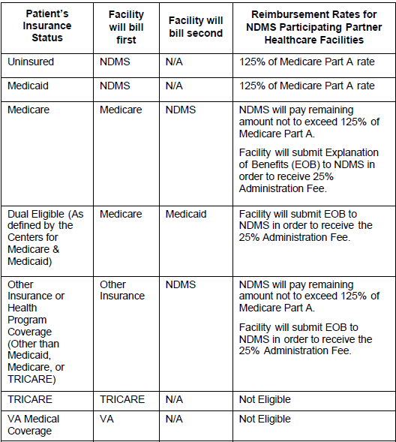
Table 1: Any NDMS Participating Partner Healthcare Facility Reimbursable Rates Under Medicare Part A
Notes:
Darryl:

Slide 25
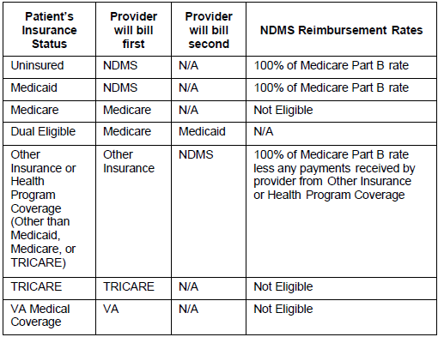
Table 2: Individual Healthcare Provider Reimbursable under Medicare Part B
Notes:
Darryl:

Slide 26
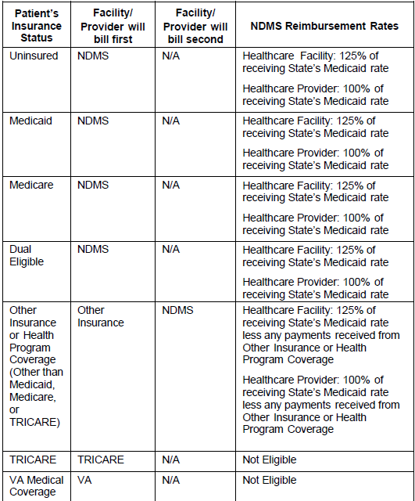
Table 3: Healthcare Partner Facility or Healthcare Provider Covered by Medicaid but not Medicare Part A/Part B

Slide 27
MOA Section 5 REIMBURSEMENTS (Cont.)
D. For NDMS federal patients eligible for military health coverage (i.e., TRICARE), payment will be made under TRICARE according to the applicable payment rates and procedures, as set forth in 32 C.F.R. Part 199.
E. For NDMS federal patients who are beneficiaries of VA healthcare, payment from VA, if any, will be made pursuant to and in accordance with VA’s applicable statutory reimbursement authorities and processes (38 U.S.C. §§ 1724, 1725, 1728, and implementing regulations).
Notes:
The NDMS Definitive Care Reimbursement Program will make no primary or secondary payments for patients with:
TRICARE coverage.
Medicare coverage.
Free care-eligible veterans treated in Veterans Affairs hospitals

Slide 28
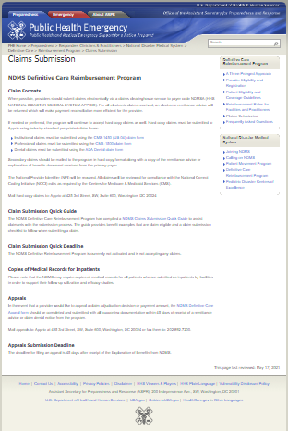
Claims submission
MOA Section 5 REIMBURSEMENTS (Cont.)
When possible, providers should submit claims electronically via a claim’s clearinghouse service.
https://www.phe.gov/Preparedness/responders/ndms/definitive-care/reimbursement-program/Pages/Claims-Submission.aspx.
If needed or preferred, the program will continue to accept hard-copy claims as well. Hard-copy claims must be submitted to Apprio using industry standard pre-printed claim forms:
Institutional claims must be submitted using the CMS-1450 (UB-04) claim form
Professional claims must be submitted using the CMS-1500 claim form
Dental claims must be submitted using the ADA Dental claim form
Notes:
Claims Submission
NDMS Definitive Care Reimbursement Program
Claim Formats
When possible, providers should submit claims electronically via a claims clearinghouse service to payer code NDMSA (HHS NATIONAL DISASTER MEDICAL SYSTEM-APPRIO). For all electronic claims received, an electronic remittance advice will be returned which will make payment reconciliation more efficient for the provider. If needed or preferred, the program will continue to accept hard-copy claims as well. Hard-copy claims must be submitted to Apprio using industry standard pre-printed claim forms:
Institutional claims must be submitted using the CMS-1450 (UB-04) claim form
Professional claims must be submitted using the CMS-1500 claim form
Dental claims must be submitted using the ADA Dental claim form
Secondary claims should be mailed to the program in hard-copy format along with a copy of the remittance advice or explanation of benefits document received from the primary payer. The National Provider Identifier (NPI) will be required. All claims will be reviewed for compliance with the National Correct Coding Initiative (NCCI) edits as required by the Centers for Medicare & Medicaid Services (CMS). Mail hard-copy claims to: Apprio at 425 3rd Street, SW, Suite 600, Washington, DC 20024
Claim Submission Quick Guide
The NDMS Definitive Care Reimbursement Program has compiled a NDMS Claims Submission Quick Guide to assist claimants with the submission process. The guide provides benefit examples that are claim eligible and a claim submission checklist to follow when submitting a claim.
Claim Submission Quick Deadline
The NDMS Definitive Reimbursement Program is currently not activated and is not accepting any claims.
Copies of Medical Records for Inpatients
Please note that the NDMS may require copies of medical records for all patients who are admitted as inpatients by facilities in order to support their follow up utilization and efficacy studies.
Appeals
In the event that a provider would like to appeal a claim adjudication decision or payment amount, the NDMS Definitive Care Appeal form should be completed and submitted with all supporting documentation within 45 days of receipt of a remittance advice or claim denial notice from the program. Mail appeals to: Apprio at 425 3rd Street, SW, Suite 600, Washington, DC 20024 or fax them to: 202.892.7200.
Appeals Submission Deadline
The deadline for filing an appeal is 45 days after receipt of the Explanation of Benefits from NDMS

Slide 29
MOA Section 5 REIMBURSEMENTS (Cont.)
F. NDMS payment will end when one of the following occurs, whichever comes first:
• Completion of medically indicated treatment ends (within 30 days or unless otherwise directed by HHS);
• Voluntary refusal of care by the NDMS federal patient; or
• Return to originating facility or other location for follow-on care.
Notes:
Coverage Period
The NDMS Definitive Care Reimbursement Program coverage ends when one or more of the following conditions is met:
the patient’s medically indicated treatment ends (maximum reimbursable duration of 30 days);
the patient voluntarily refuses care;
thirty calendar days have elapsed from the date of the patient’s evacuation/placement; or
the patient is returned home or to the point of origin (or a fiscally comparable location) or to the patient’s destination of choice.

Slide 30
MOA Section 5 REIMBURSEMENTS (Cont.)
G. Reimbursement for medical care provided beyond 30 days is subject to availability of funding and approval by HHS.
H. HHS will work directly with a Financial Intermediary/Definitive Medical Care contractor to process submitted claims.
Notes:
Note: the NDMS Definitive Care Reimbursement Program does not supersede contracts that providers have with other payers which require the payer’s reimbursement be accepted as payment in full (also referred to as “Assignment”). In these cases where the provider has agreed to accept Assignment from another payer, the NDMS Definitive Care Reimbursement Program will not make any secondary payments.

Slide 31
MOA Section 5 REIMBURSEMENTS (Cont.)
Fee-for-Service Adjustment Factor – NDMS reserves the right to apply an adjustment factor to a Provider’s reimbursement calculated using Medicare or Medicaid rates and methodologies to approximate total reimbursement under Medicare or Medicaid in the event that future reimbursement changes make reimbursement determinations using traditional fee-for-service methodologies incomplete or impractical.
Examples of situations where this could be applied include, but are not limited to,
Centers for Medicare and Medicaid Services (CMS) waivers,
Bundled pricing arrangements
Accountable Care Organizations, and other alternative payment models.
Notes:
Fee-for-Service Adjustment Factor -NDMS reserves the right to apply an adjustment factor to a Provider’s reimbursement calculated using Medicare or Medicaid rates

Slide 32
MOA Section 5 REIMBURSEMENTS (Cont.)
J. International Patients and Undocumented Persons – Subject to authority, available appropriations, and NDMS approval, NDMS partner healthcare facility and/or healthcare providers caring for international patients or undocumented persons may be reimbursed using the same reimbursement rates and provisions as outlined in this Agreement.
Notes:
International Patients and Undocumented Persons
Subject to authority, available appropriations
using the same reimbursement rates and provisions as outlined in this Agreement

Slide 33
MOA Section 5 REIMBURSEMENTS (Cont.)
K. Subject to authority, available appropriations, and NDMS approval, foreign providers and facilities performing inpatient facility care, physician, or ambulance services may be reimbursed on a submitted charges basis provided that the total charges do not grossly exceed typical Medicare reimbursement. This includes locations other than the 50 states of the U.S., the District of Columbia, Puerto Rico, the U.S. Virgin Islands, Guam, American Samoa, the Northern Mariana Islands, and the Freely Associated States (FAS) (the Federated States of Micronesia (FSM), the Republic of the Marshall Islands (RMI), and the Republic of Palau), Subject to the following limitation: the emergency occurred within the U.S. or its territories and the foreign hospital is closer than the nearest U.S. hospital that can treat the medical condition.
Notes:
Foreign providers and facilities performing inpatient facility care
Subject to authority, available appropriations -may be reimbursed on a submitted charges basis provided that the total charges do not grossly exceed typical Medicare reimbursement
Subject to the following limitation:
the emergency occurred within the U.S. or its territories and
the foreign hospital is closer than the nearest U.S. hospital that can treat the medical condition.

Slide 34
MOA Section 5 REIMBURSEMENTS (Cont.)
L. Facilities, at the time of executing this Agreement, must have obtained accreditation from a CMS-recognized accrediting body or an accrediting body recognized by a state’s Medicaid program. In order to be eligible for reimbursement under this Agreement, the NDMS partner healthcare facility must still be accredited and in good standing during the date(s) of service provided to NDMS federal patient(s). Providers must be a participant in either Medicare or Medicaid and not have been disbarred from the state or federal program. This Agreement does not cover routine vision, dental and hearing care, but does cover emergency vision, dental, and hearing cases. Should a healthcare facility elect not to execute the MOA, the facility will be limited to 100% of the applicable reimbursement rate through normal reimbursement processes (e.g., through CMS direct) and will not be eligible for the 25% administrative fee.
M. The Employer Identification Number to be used for the NDMS is 26-1864515.
Notes:
Centers for Medicare & Medicaid Services.
Healthcare facility must still be accredited and in good standing during the date(s) of service
Providers must be a participant in either Medicare or Medicaid and not have been disbarred from the state or federal program
This Agreement does not cover routine vision, dental and hearing care, but does cover emergency vision, dental, and hearing cases
Should a healthcare facility elect not to execute the MOA, the facility will be limited to 100% of the applicable reimbursement rate through normal reimbursement

Slide 35
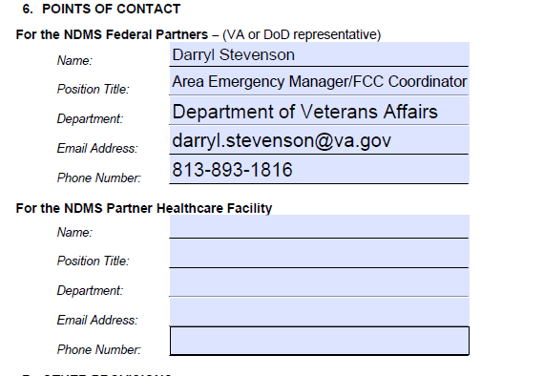
MOA Section 6 Points Of Contact
Notes:
Darryl:

Slide 36
MOA Section 7 Other Provisions
A Not withstanding anything in this Agreement, each of the NDMS Federal Partners shall have the exclusive authority to direct its employees and to implement its own statutory responsibilities.
B. Nothing in this Agreement is intended to conflict with current federal or state law, or the regulations, agreements, or directives of the NDMS Federal Partners or the NDMS partner healthcare facility. If a term of this Agreement is inconsistent with such authority, then that term shall be invalid, but the remaining terms and conditions of this Agreement shall remain in full force and effect.
Notes:
Darryl:

Slide 37
MOA Section 8 & 9 Other Provisions
8. EFFECTIVE DATE of MOA
This Agreement shall become effective upon signature of one of the NDMS Federal Partners and the NDMS partner healthcare facility.
9. INFORNATION LAWS
The agreement may be canceled at any time by written consent of the NDMS partner healthcare facility and any of the NDMS Federal Partners. The agreement also may be terminated by either the NDMS partner healthcare facility or any of the NDMS Federal Partners upon giving 90 days written notice to the other party. Unless otherwise noted, this Agreement shall remain in effect for a period not to exceed five years upon date of the last signature.
Notes:
37
Darryl

Slide 38
MOA Section 10 Other Provisions
10. INFORMATION LAWS
All parties understand and will adhere to the Health Insurance Portability and Accountability Act of 1996 (HIPAA) and the Privacy Act, to the extent these laws are applicable.
Notes:
38
Darryl

Slide 39
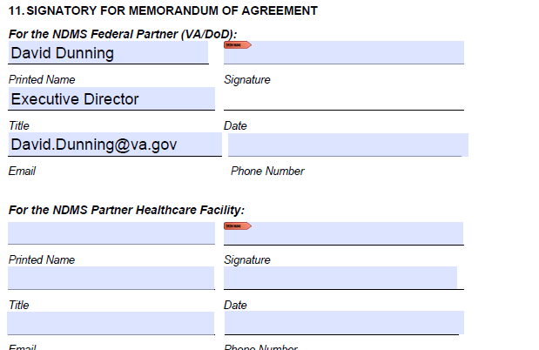
MOA
Signatures on MOA
For the NDMS Federal Partners- FCC Director- VAMC Director
For the NDMS Health Care Facility- CEO or Designee
Notes:
39
Darryl

Slide 40
Questions/Discussion
Darryl Stevenson
13000 Bruce B. Downs Tampa, FL 33612
VHA Office of Emerg Mgt (OEM)
Darryl.Stevenson@va.gov
C: 813-893-1816
Dawn Stevenson
1201 N.W. 16th St. Miami, FL 33125
VHA Office of Emerg Mgt(OEM)
Dawn.Stevenson2@va.gov
W: (305) 575-5000 x17568
C: (786) 589-2440

